Slide 1
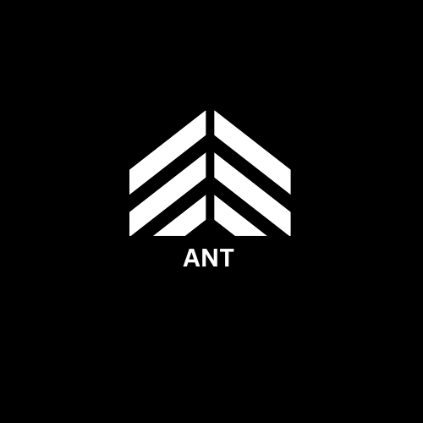
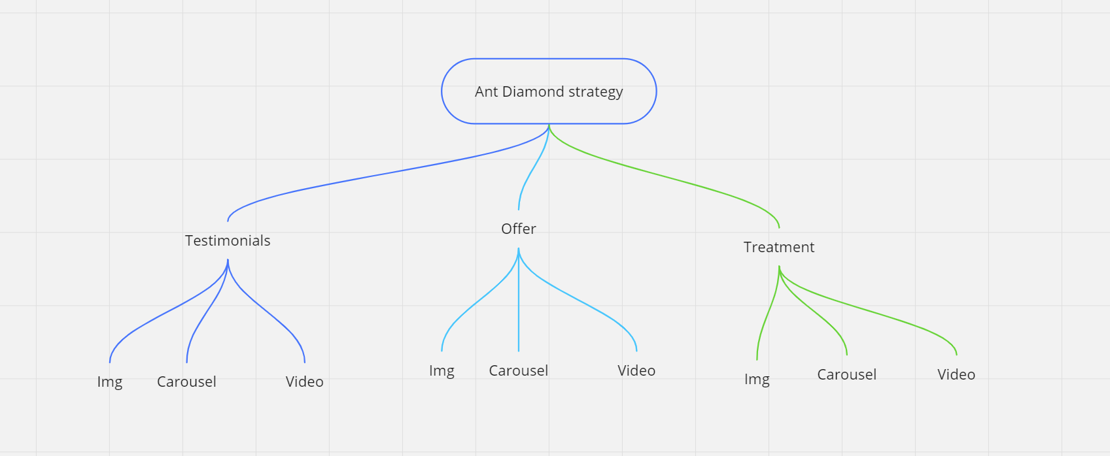
ANT Diamond Formation
Minimum Ad spent Maximum output

Slide 2
How will we reduce Ad spent over a period of time ??
Organic Growth - posting to create a brand image rather than focusing on lead generation.
Api integration - Happy birthday , precautions ,

Slide 3
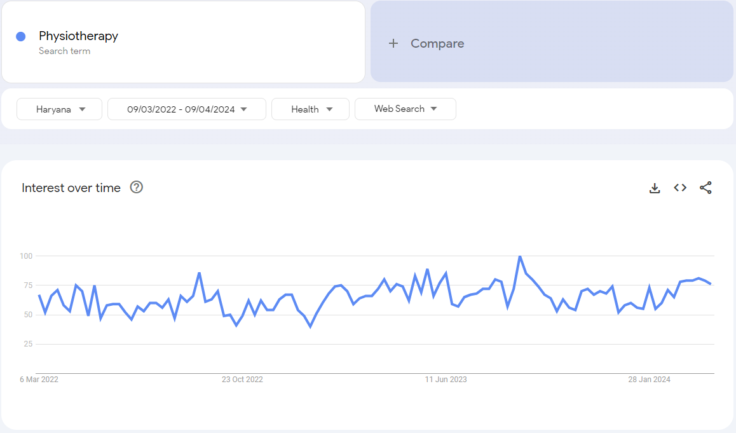
Keyword Insights

Slide 4
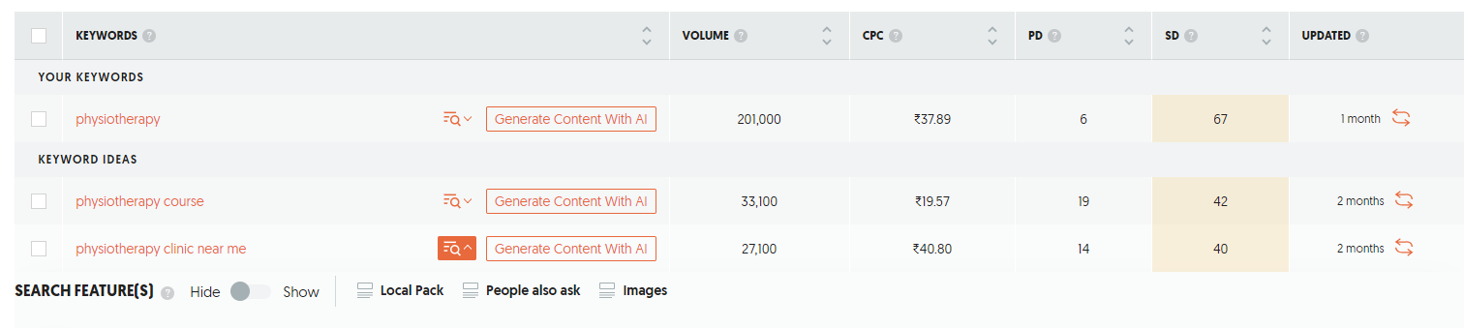
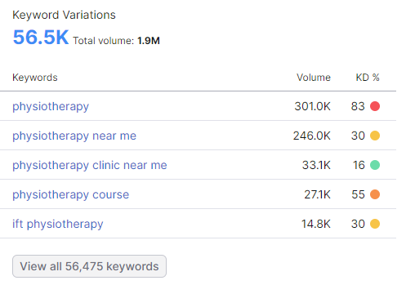
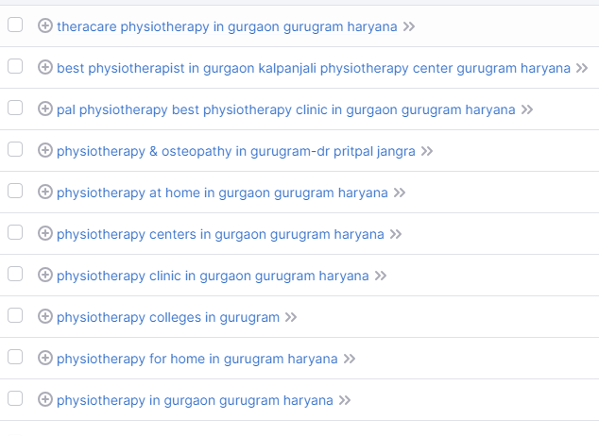

Slide 6
Some Advantages about your clinic -
Personalized rehabilitation center
Long wave therapy machine
Prime Location
Laser therapy

Slide 7
Clinic’s
Customer Footfall Trend
FB account?
Insta Account
Leads thru social media
1
Painsmith clinic
6 to 8
200 follow
2
Wellness first clinic
9 to 12
1.1k follow
242 follow
Yes
3
Uday Yadav physiotherapy
12 to 6
7.4k follow
8.6k follow
Yes
4
India physios
3 to 6
600 follow
5
Healing hub physical therapy
9 to 12
876 follow
8.6k follow
Yes
6
Synergy physiotherapy and wellness center
9 to 9
1.3k follow
Yes

Slide 8
The one who are getting the most amount of leads are present in the industry–

Slide 9
The one who are getting the most amount of leads are present in the industry–
Leverage social media
Create Awareness
Building Brand self image

Slide 10
OFFER!!

Slide 11
